Slide 1
HITS: Hyperlink-Induced Topic Search
Link Analysis with Hubs and Authorities

Slide 2
An Idea Behind HITS
Query-Dependent Ranking

Slide 3
Two Approaches to Page Ranking
Query-independent ranking: Ranks are independent of queries (like ranks computed with PageRank).
Query-dependent ranking: Each query determines its own ranks on pages (ranks computed with HITS are query-dependent).
Which is better?
Strength of query-independent ranking. Query processing is efficient: ranks are computed in advance, not during query processing.
Strength of query-dependent ranking. For many queries, there are pages that are highly authoritative on the query topic, but they are not necessarily very authoritative in general.

Slide 4
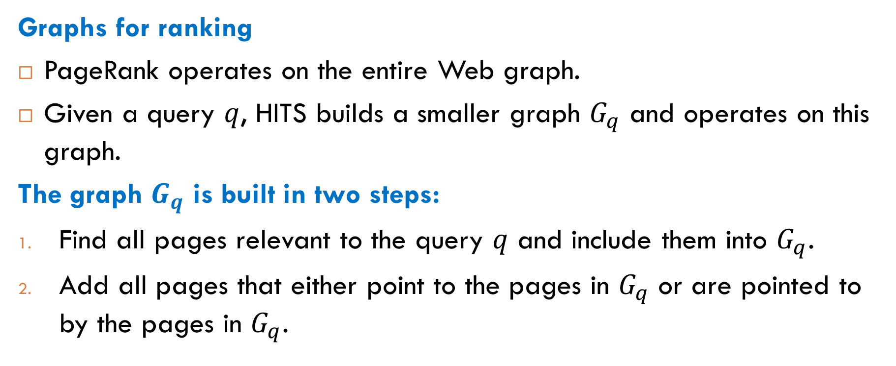
Smaller Graph in HITS
Graphs for ranking
PageRank operates on the entire Web graph.
Given a query $q$, HITS builds a smaller graph $G_{q}$ and operates on this graph.
The graph $G_{q}$ is built in two steps:
Find all pages relevant to the query $q$ and include them into $G_{q}$.
Add all pages that either point to the pages in $G_{q}$ or are pointed to by the pages in $G_{q}$.

Slide 5
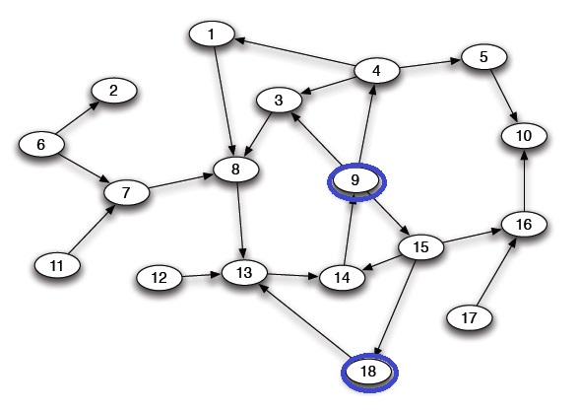
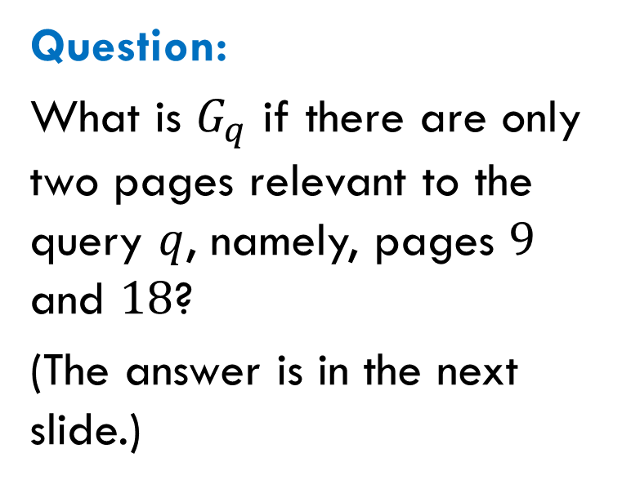

Example
The Web graph $G$:
Question:
What is $G_{q}$ if there are only two pages relevant to the query $q$, namely, pages $9$ and $18$?
(The answer is in the next slide.)

Slide 6
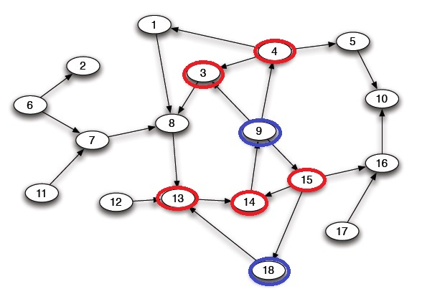
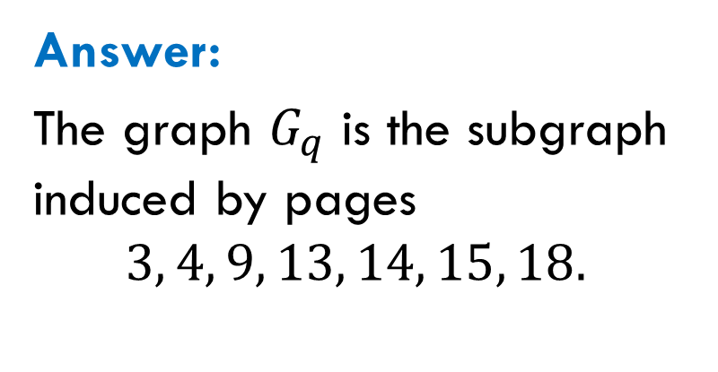
Example
The Web graph $G$:
Answer:
The graph $G_{q}$ is the subgraph induced by pages
$$3, 4, 9, 13, 14, 15, 18.$$

Slide 7
Another Idea Behind HITS
Hubs and Authorities

Slide 8
Two Types of Pages
Question. When googling “newspapers in Chicago”, what are you actually looking for?
Are you looking for websites of Chicago major newspapers? Then you need the webpages of Chicago Tribune, Chicago Sun-Times, etc. These pages have high authority.
Are you looking for information about all newspapers published in Chicago? Then you need, for example, Wikipedia’s article “Newspapers of the Chicago metropolitan area”. Such a page acts as a hub that contains a collection of links to authoritative pages.

Slide 9
Combination of Two Weights
Two weights. The rank assigned by HITS to a page is a combination of the following two weights:
The authority weight captures the quality of the page as a resource itself.
The hub weight captures the quality of the page as a pointer to useful resources.
Key idea. How to define these weights? A key idea of HITS is mutual reinforcing: a good hub points to good authorities, while a good authority is pointed to by good hubs.

Slide 10
Hub-Authority Computation

Slide 11
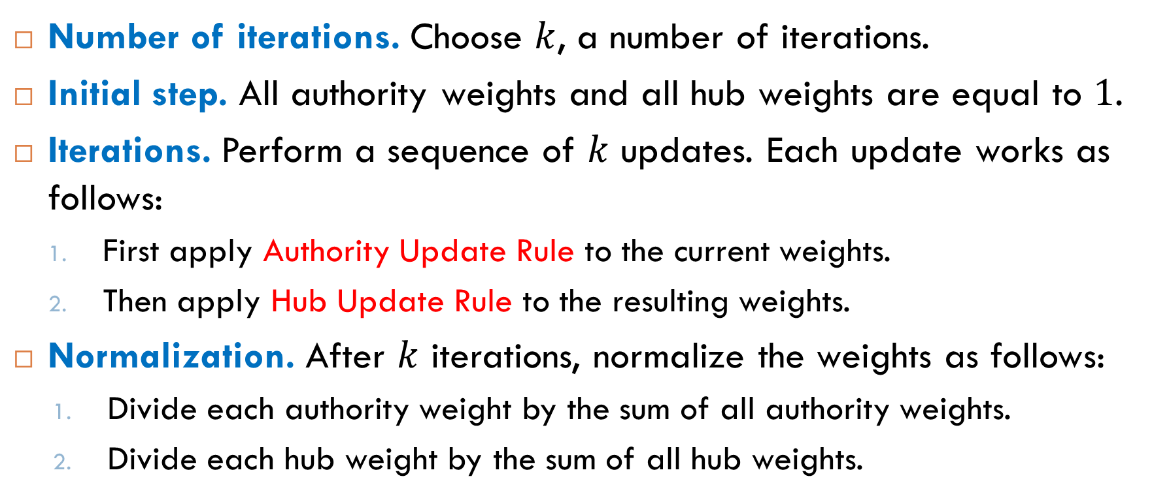
General Scheme
Number of iterations. Choose $k$, a number of iterations.
Initial step. All authority weights and all hub weights are equal to $1$.
Iterations. Perform a sequence of $k$ updates. Each update works as follows:
First apply Authority Update Rule to the current weights.
Then apply Hub Update Rule to the resulting weights.
Normalization. After $k$ iterations, normalize the weights as follows:
Divide each authority weight by the sum of all authority weights.
Divide each hub weight by the sum of all hub weights.

Slide 12
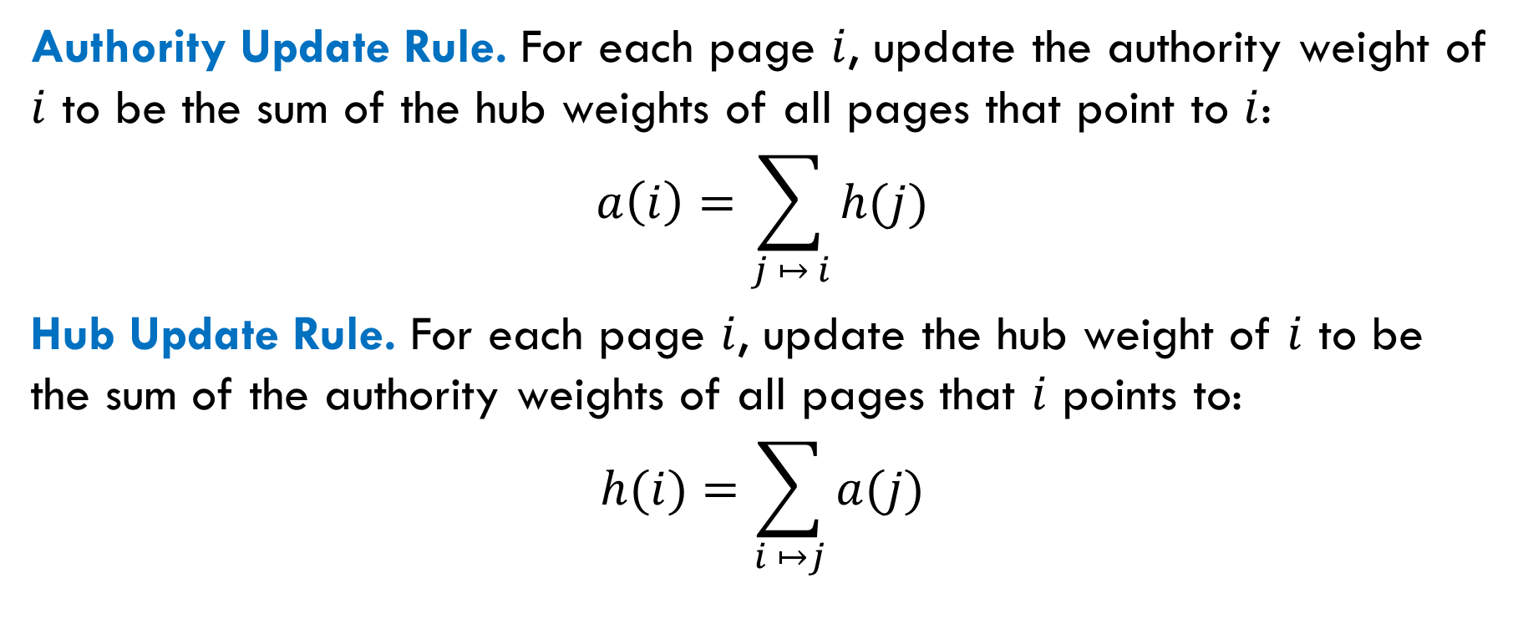
Update Rules
Authority Update Rule. For each page $i$, update the authority weight of $i$ to be the sum of the hub weights of all pages that point to $i$:
$$a\left(i\right)=\sum_{j ↦ i}{h(j)}$$
Hub Update Rule. For each page $i$, update the hub weight of $i$ to be the sum of the authority weights of all pages that $i$ points to:
$$h(i)=\sum_{i ↦j}{a(j)}$$

Slide 13
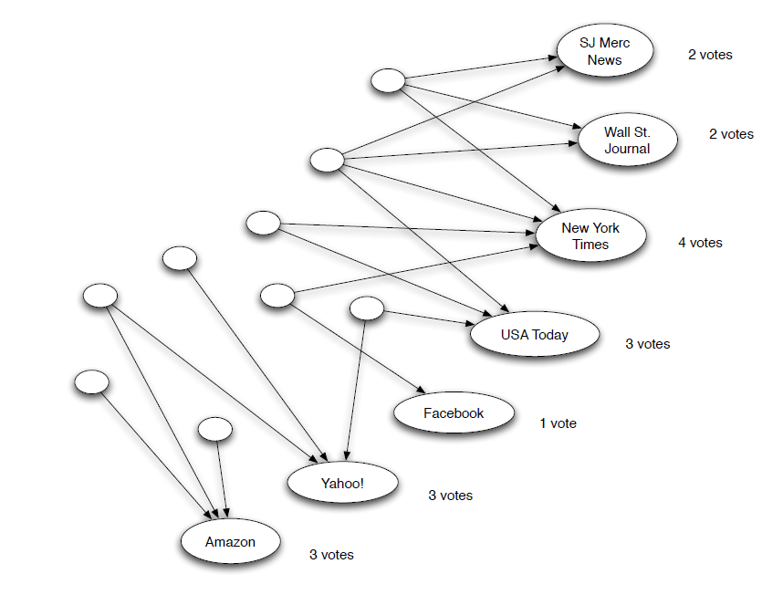
Step 1: Updating Authority Weights

Slide 14
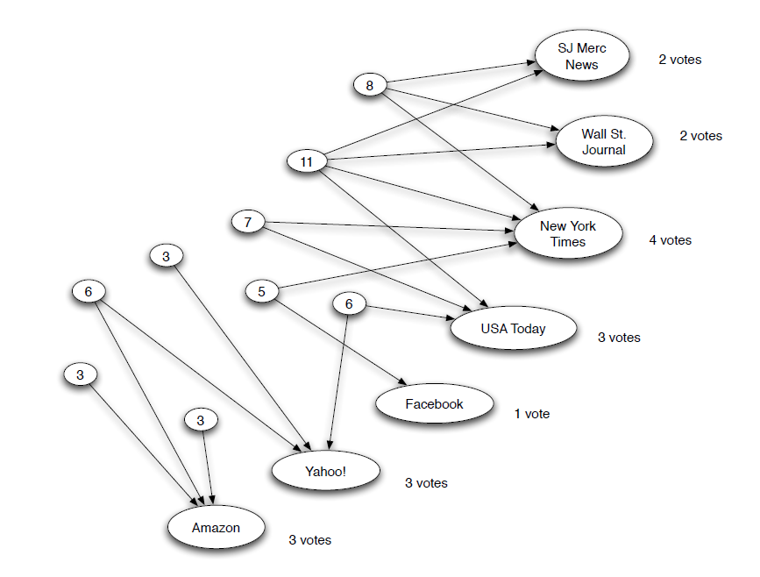
Step 1: Updating Hub Weights

Slide 15
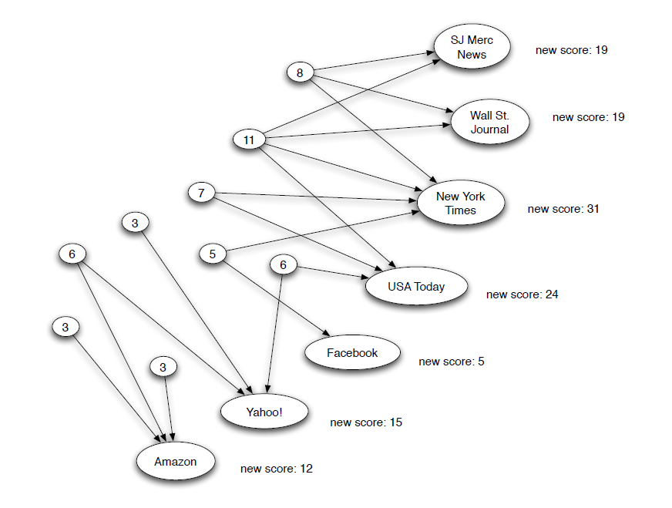
Step 2: Updating Authority Weights

Slide 16
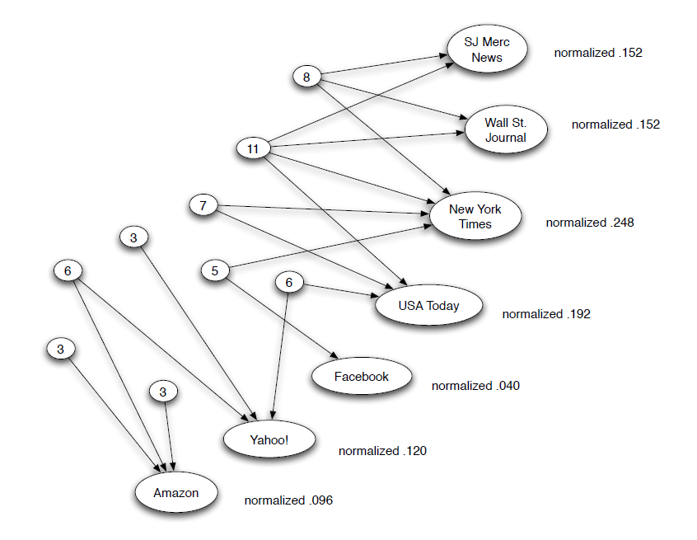
Normalizing Authority Weights

Slide 17
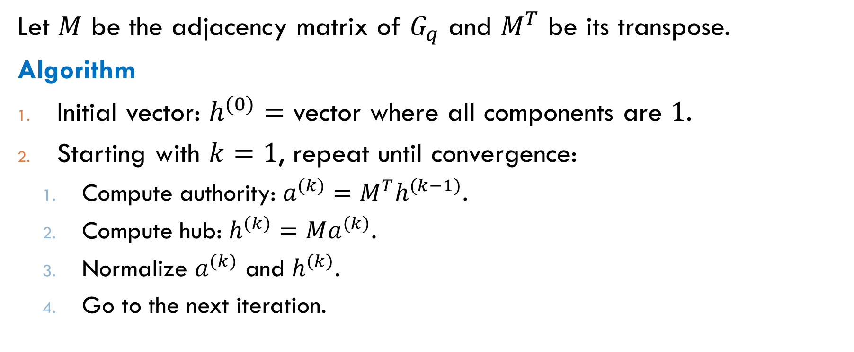
Computation of Authority and Hub Weights
Let $M$ be the adjacency matrix of $G_{q}$ and $M^{T}$ be its transpose.
Algorithm
Initial vector: $h^{(0)}=$ vector where all components are $1$.
Starting with $k=1$, repeat until convergence:
Compute authority: $a^{(k)}=M^{T}h^{(k−1)}$.
Compute hub: $h^{(k)}=Ma^{(k)}$.
Normalize $a^{(k)}$ and $h^{(k)}$.
Go to the next iteration.

Slide 18
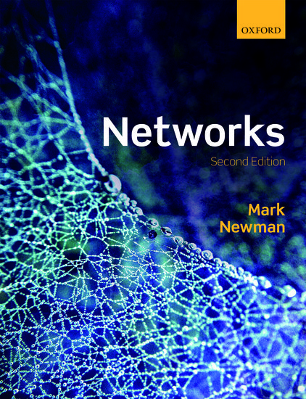

Reading
Section 7.1.5
Section 14.2

